Slide 1
Compiler
Chapter 3 – Lexical Analysis
Tien-Hsiung Weng
翁添雄
靜宜大學資工系
thweng@pu.edu.tw
Lecture 2

Slide 2
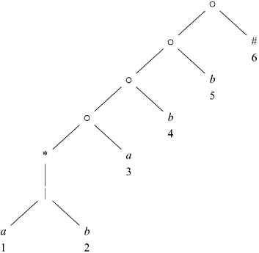
Converting a RE Directly to a DFA
Example Syntax tree for (a|b)*abb#

Slide 3
Converting a RE Directly to a DFA
Functions computed from the syntax tree:
  nullable., fistpos, lastpos, and followpos
Each definition refers to the syntax for a particular augmented RE (r)#
1. nullable(n) is true for a syntax-tree node n iff the subexpression represented by n has ε in its language.
2. firstpos(n) is the set of positions in the subtree rooted at n that correspond to the first symbol of at least one string in the language of the subexpression rooted at n.
3. lastpos(n) is the set of positions in the subtree rooted at n that correspond to the last symbol of at least one string in the language of the subexpression rooted at n.
4. followpos(p), for a position p, is the set of positions q in the entire syntax tree such that there is some string x=a₁a₂a₃…a_{n} in L((r)#) such that for some i, there is a way to explain the membership of x in L((r)#) by matching a_{i}, to position p of the syntax tree and a_{i+1} to position q.

Slide 4
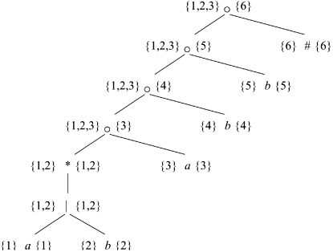
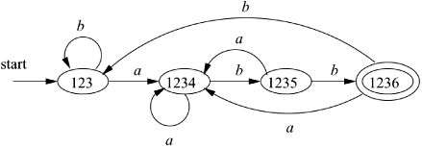
Converting a RE Directly to a DFA
Node n | followpos(n)
1 | {1,2,3}
2 | {1,2,3}
3 | {4}
4 | {5}
5 | {6}
6 | ∅
Converting a RE directly from a DFA
Example Syntax tree for (a|b)*abb#
DFA State | a | b
{1,2,3} A | {1,2,3,4} B | {1,2,3} A
{1,2,3,4} B | {1,2,3,4} B | {1,2,3,5} C
{1,2,3,5} C | {1,2,3,4} B | {1,2,3,6} D
{1,2,3,6} D | {1,2,3,4} B | {1,2,3} A

Slide 5
Converting a RE Directly to a DFA
Algorithm for converting a RE Directly to a DFA
Input: A RE r
Output: A DFA D that recognizes L(r)
Method:
Construct a syntax tree T from the augmented RE (r)#
Compute nullable, firstpos, lastpos, followpos for T
Construct Dstates, the set of states of DFA D, and Dtran, the transition function for D using the following procedure. The states of D are sets of position in T. Initially, each state is “unmarked”, and a state becomes “marked” just before we consider its out-transitions. The start state of D is firstpos(n0), where node n0 is the root of T. The accepting states are those containing the position for the endmarker symbol #.

Slide 6
Converting a RE Directly to a DFA
Initialize Dstates to contain only the marked state firstpos(n₀), where n0 is the root of syntax tree T for (r)#;
While (there is an unmarked state S in Dstates) {
mark S;
for (each input symbol a) {
let U be the union of followpos(p) for all p in S that correspond to a;
if (U is not in Dstates) add U as an unmarked state to Dstates;
Dtran[S,a] = U;
}
}

Slide 7
Minimize the number of states of a DFA
Input: A DFA D with set of states S, input alphabet Σ, start state s0, and set of accepting states F.
Output: A DFA D’ accepting the same language as D and having as few states as possible
Method:
1. start with an initial partition Π with two groups, F and S – F, the accepting and nonaccepting states of D
2. apply the following algorithm to construct a new partition Π_{new}.
Initially, let Π_{new} = Π;
For (each group of Π) {
partition G into subgroups such that two states s and t are in the same subgroup iff for all input symbols a, stats s and t have transitions on a states in the same group of Π;
/*at worst, a state will be in a subgroup by itself */
Replace G in Π_{new} by the set of all subgroups formed;
}
3. If Π_{new} = Π, let Π_{final} = Π and continue with step (4). Otherwise, repeat step (2) with Π_{new} in place of Π.
4. Choose one state in each group of Π_{final} as the representative for that group. The representatives will be the states of the minimum-state DFA D’.

